Slide 1
Robotic Machine Perception
By: Anthony Lathrop

Slide 2
Questions
Machine Perception?
What is Machine Perception?
Why?

Slide 3
What is my goal?
In Data Science, we are concerned with making predictions…
My goal is to enable robot perception with Data Science techniques
How would I do this? What kind of perception would I enable?

Slide 4
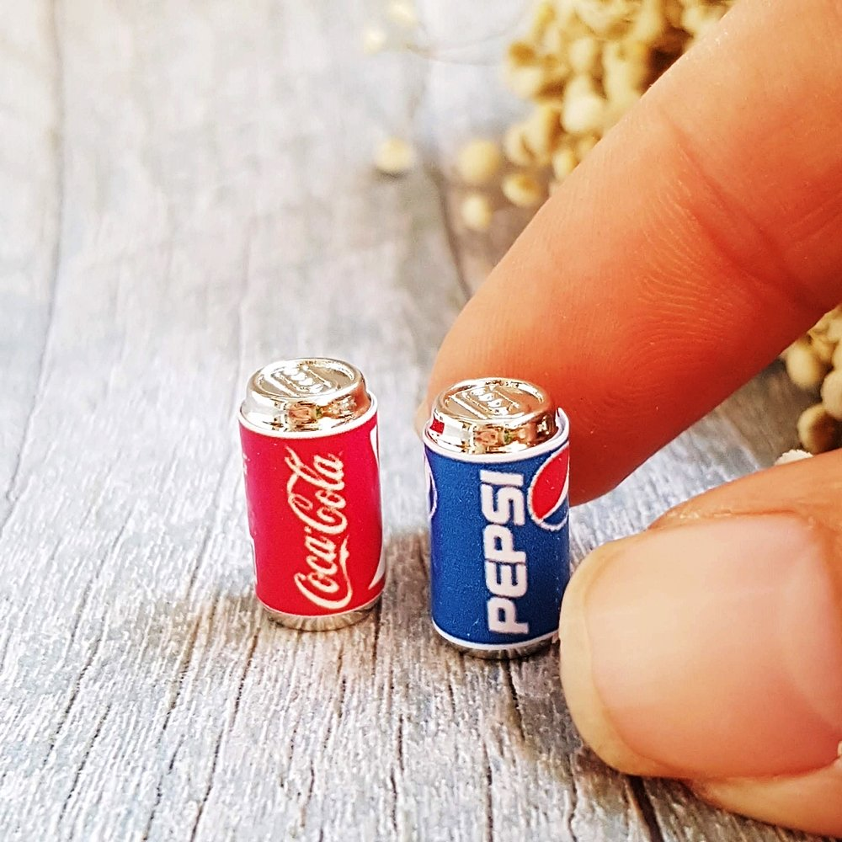

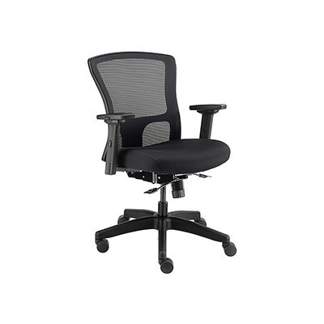
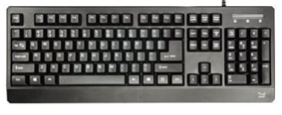
The Data
I used the CIFAR 100 dataset
Objects found in household or office settings
Context for my image classifier

Slide 5
Preprocessing Images
Scaling Pixel Data
Reshaping Images into 4-Dimensional Tensors
What is a Tensor?

Slide 6
Modeling
Use Convolutional Neural Network (CNN)
Convolution passes a filter over an input image…
Max Pooling takes the maximum value to reconstruct the image

Slide 7
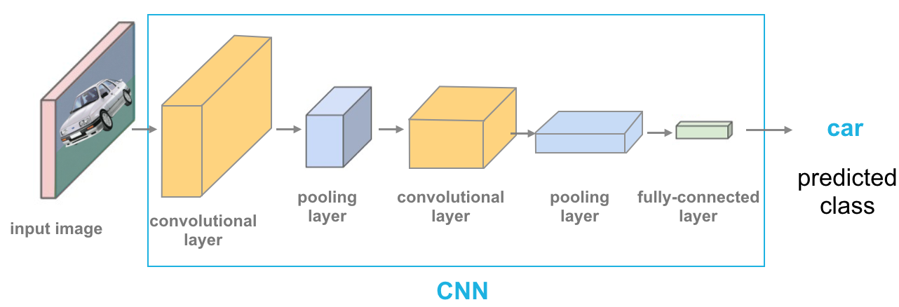
Modeling

Slide 8
What did my model predict?
For each image in the dataset,
I predicted a specific object class
I predicted a more general object class

Slide 9
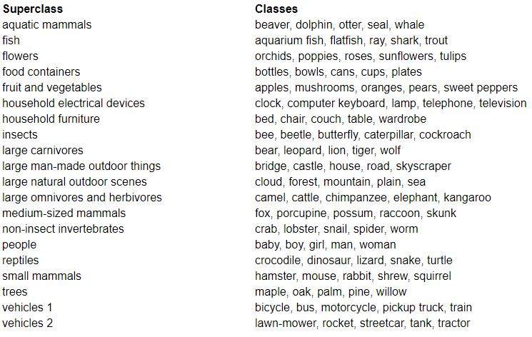
Classes

Slide 10
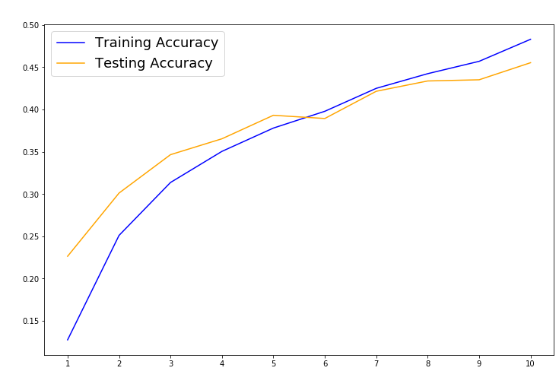
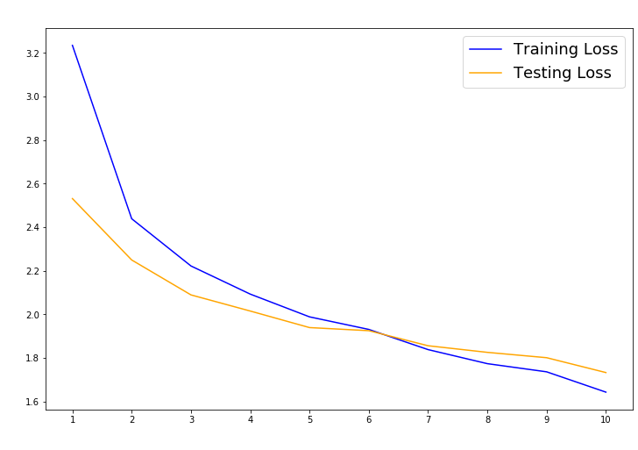
How did my model perform?

Slide 11
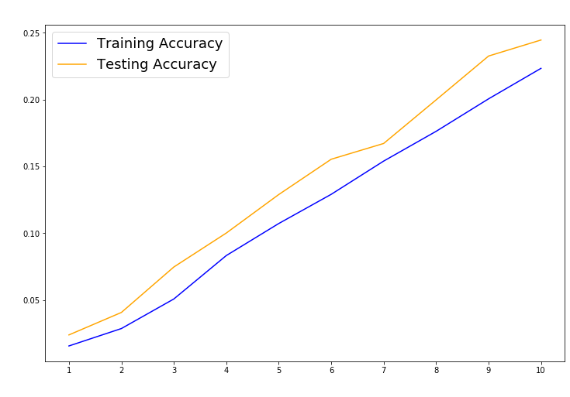
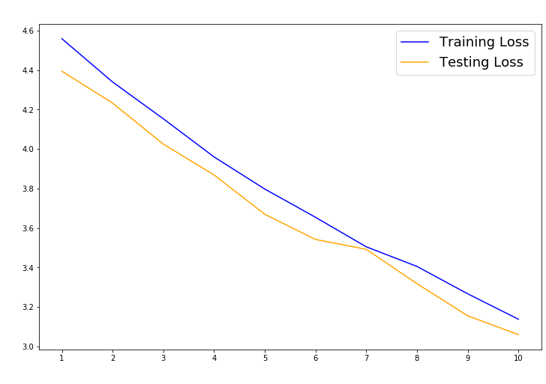
How did my model perform?

Slide 12
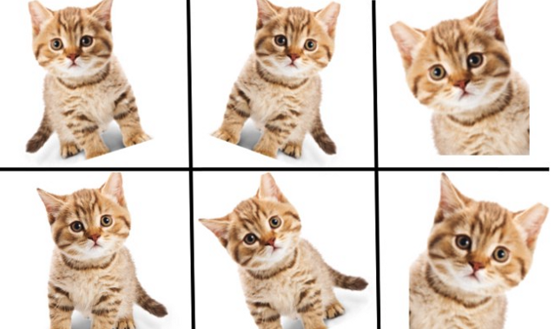
Model Improvement
Data Augmentation
Residual Net Layer

Slide 13
Why is this important?
Household Robotics
Manufacturing Robotics
Self Driving Cars
Infrastructure

Slide 14
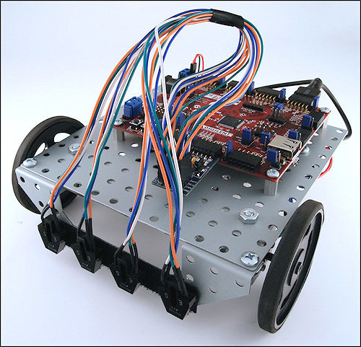
Future Project Goals
Create a classifier on an iPhone
Create a decision making framework for a robotic vehicle

Slide 15
Thank You

